Slide 1
Project Profilation using Skill analysis by applying Formal Context Analysis and Stable matching
Stage 1: Skill Extraction
Stage 2: Formal Context Analysis (FCA)
Stage 3: Stable matching (or Stable Marriage Problem)

Slide 2
Stage 1: Skill Extraction
DATABASE
No. of Projects: 136
No. of Technical Skills: 1774
No. of Non-Technical Skills: 1140
No. of Projects taken for Training:
No. of Projects taken for Testing:

Slide 3
Technical Skill Extraction
Flowchart:

Slide 4
Work Done:

Slide 5
Non-Technical Skill Extraction
Flowchart:

Slide 6
Work Done:

Slide 7
Example:
Abstract

Slide 8
Output:

Slide 9
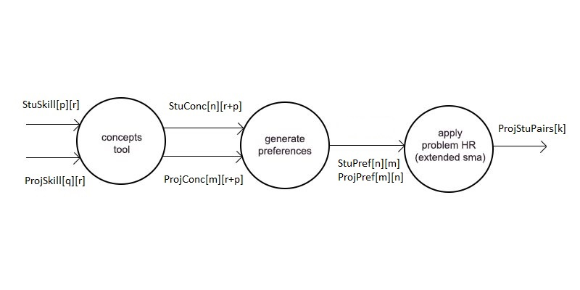
DFD

Slide 10
Stage 2: Formal Context Analysis
Input:
Conversion of Project-Skill data into Table, ProjSkill[q][r].
Conversion of Student-Skill data into Table, StuSkill[p][r].
Output :
Project-Skill Concept matrix, ProjConc[n][r+q]
Student-Skill Concept matrix, StuConc[m][r+p]

Slide 11
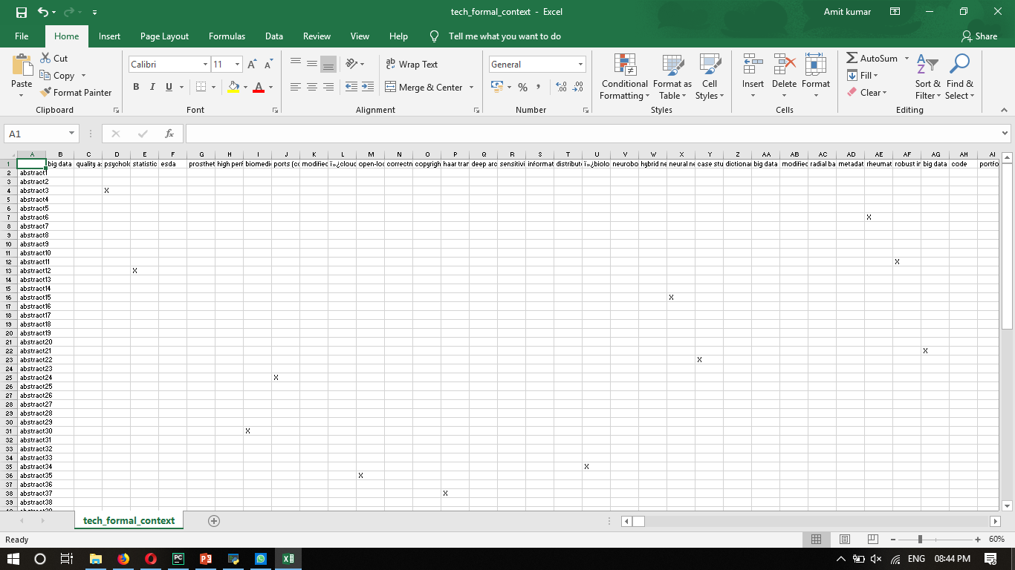
Table 1: Project-Skill

Slide 12
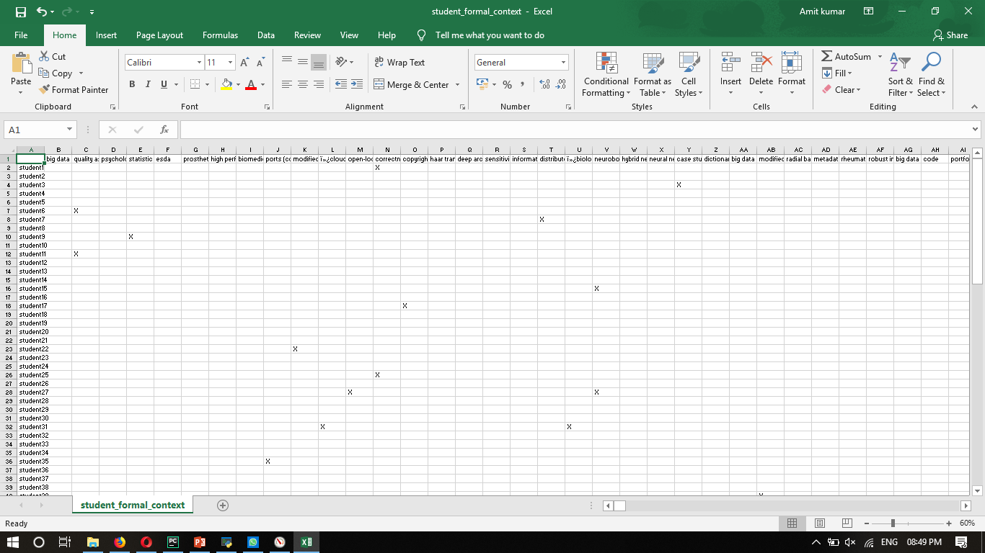
Table 2: Student-Skill

Slide 13
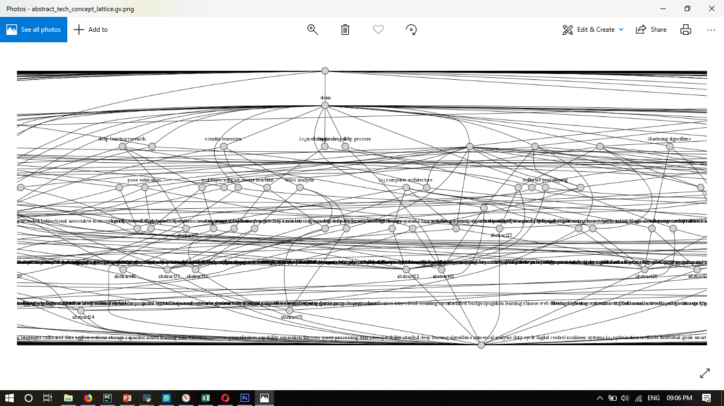
Output:
Project-Skill FCA:

Slide 14
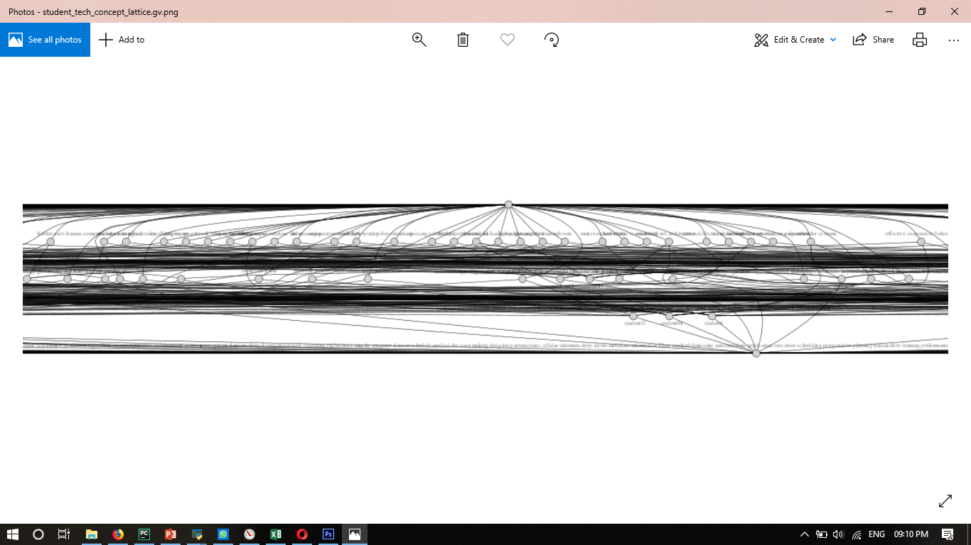
Student-Skill FCA:

Slide 15
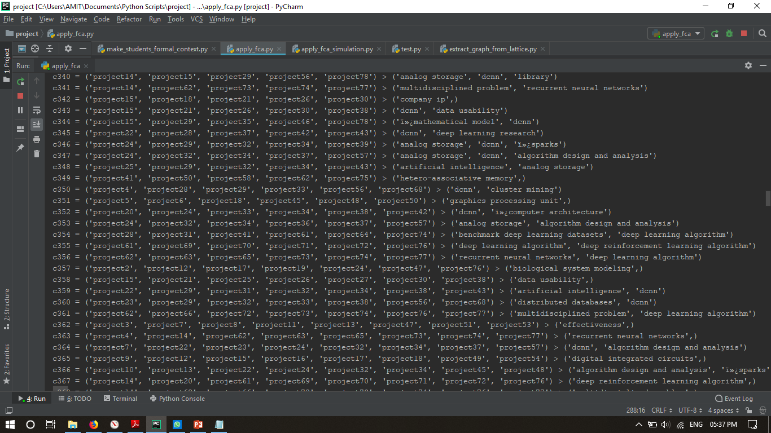
Project-Skill formal concept

Slide 16
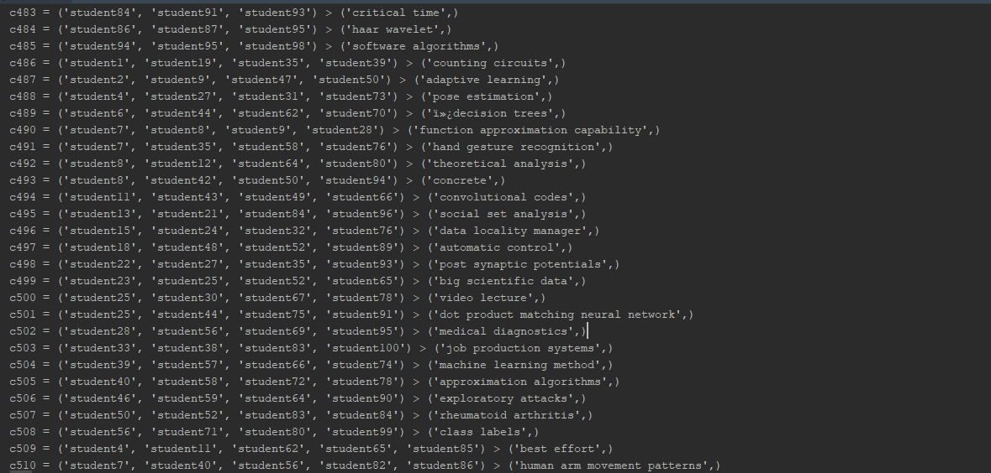
Student skill formal concept

Slide 17
Project-Skill FCA
No. of Nodes:384
No. of Edges:973
Student-Skill FCA
No. of Nodes:514
No. of Edges:1388

Slide 18
Generate Preferences
Input :
Project-Skill Concepts and Student-skill Concepts matrix.
StuConc[n][r+p], ProjConc[m][r+q].
Output :
List of Preferences for each Student, StuPref[n][m].
List of Preferences for each Project, ProjPref[m][n].

Slide 19
Generate Affinity Matrix :
For each team i in StuConc do {
For each task j in ProjConc do {
Aff[i][j]:= 0
For each skill Sk in Skill{1..r} do {
If (TESC[i][k] = 0 AND TASC[j][k] = 1) then
Aff[i][j] := Aff[i][j] + a*TESC[i][k]
Else if (TESC[i][k] = 0 AND TASC[j][k] = 0) then
Aff[i][j] := Aff[i][j] + b
Else if (TESC[i][k] = 0 AND TASC[j][k] = 0) then
Aff[i][j] := Aff[i][j] - c*TESC[i][k]
Else
Aff[i][j] := Aff[i][j] - d }
}
}
}
2. Generate Preferences for each Project and Student according to Affinity matrix.

Slide 20
Stage 3: Stable Marriage
Input:
Student and Project Preferences, StuPref[n][m], ProjPref[m][n].
Output :
List of best matching Project-concept & Student-concept pairs.

Slide 21
Process :
Hospital oriented Hospital-resident problem
(extended stable marriage problem )
For each R in resident do{
free[R] := True
}
While H in hospitals and H’s list contain R not allotted to H do {
r := first R not allotted to H
if r is Assigned to H’ then
break assignment (r, H’)
assign r to H
for each successor H’ of H in r’s list do {
remove H’ and r from each others list
}
}

Slide 22
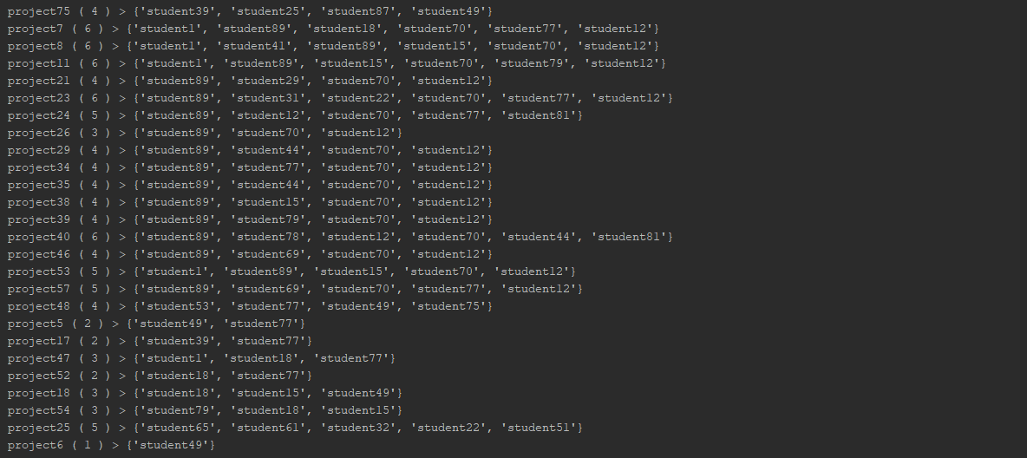
Output :
some list of students included in projects

Slide 23
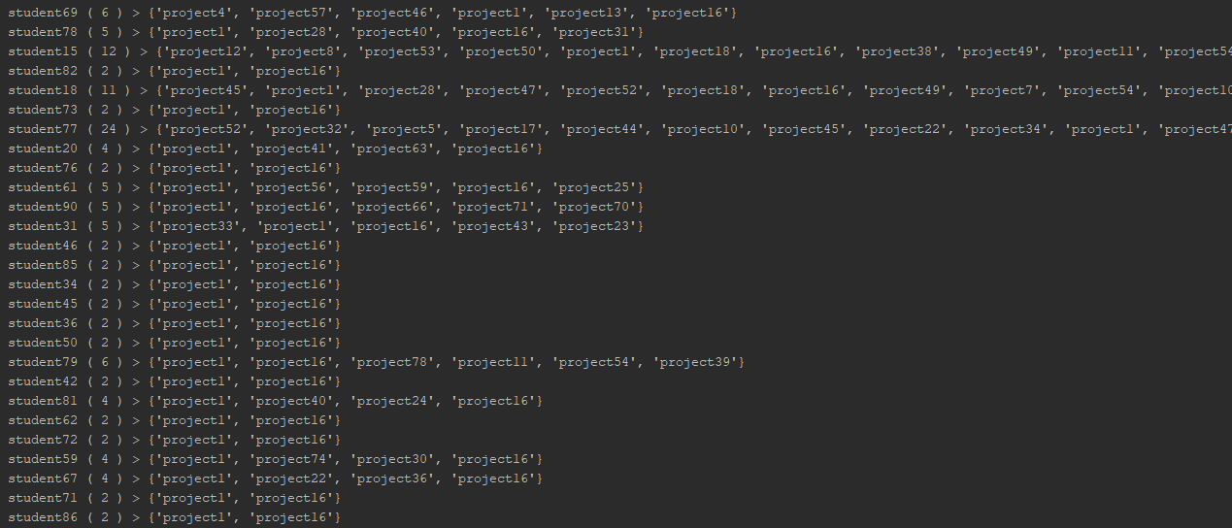
some list of projects allotted to each student

Slide 24
Future Scope:
Course Suggestions

